Slide 1
Nutritional Labels for Automated Decision Systems: Classifying Toxic Comments
Presented by: Aishwarya Manojkumar and Caoilin Donnelly

Slide 2
1.
Background
General information about the ADS

Slide 3
Perspective API
Perspective API is an ADS that utilizes machine learning models to flag abusive or ”toxic” user comments online. This is done by being given an input of a comment and the machine learning models assess the comment in eight different categories:
Toxicity • Severe Toxicity • Insult • Sexually Explicit • Profanity • Likely to Reject • Threat • Identity Attack

Slide 4
Goals and Tradeoff
The stated goals of Perspective API are:
To give developers and publishers the tools to give feedback to commenters
Help moderators review comments easier
Help filter out ”toxic” language.
The biggest trade-off with perspective API is the inability to choose which of the eight categories (as a developer or moderator) you want perspective API to pick up on.

Slide 5
2.
Outcomes
General information about the ADS

Slide 6
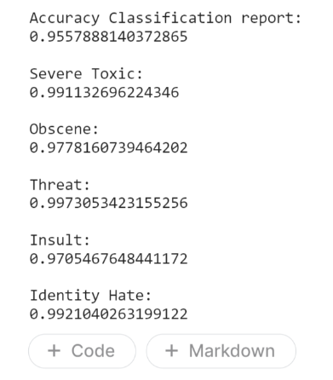

Accuracy Across Features

Slide 7
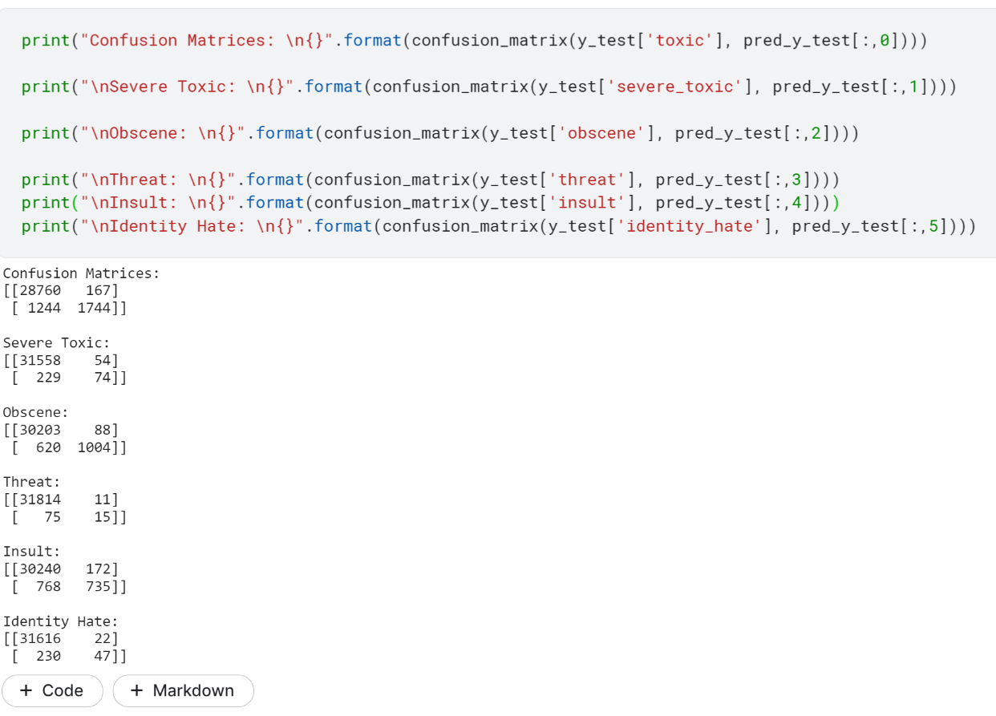
Fairness Measures-Confusion Matrices
To evaluate the fairness of the classifier we chose to use confusion matrix to calculate the proportion of False Positives and False Negatives to Total Comments Classified Under a Feature

Slide 8
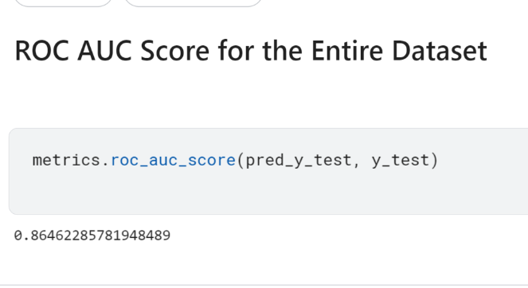
Analyzing ADS Performance
AUC provides an aggregate measure of performance across all possible classification thresholds. This score is important because it evaluates the performance for the ADS overall and not based on features.

Slide 9
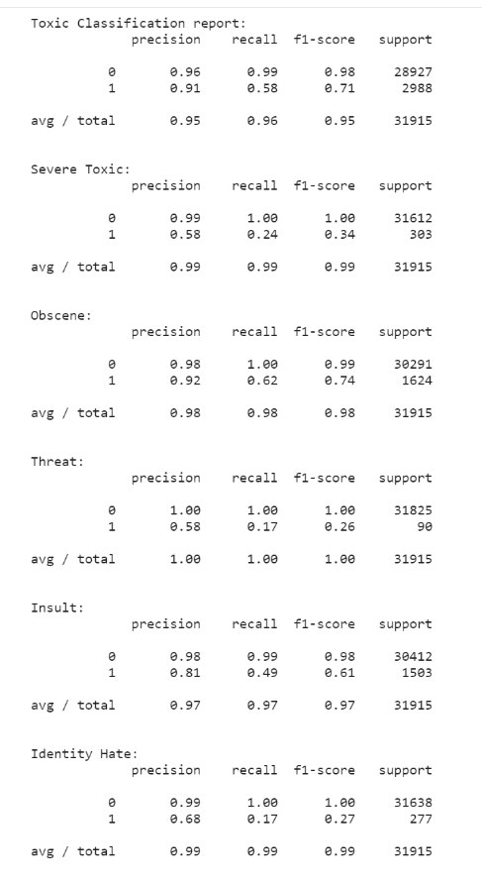
Analyzing ADS Performance

Slide 10
3.
Summary
General information about the ADS

Slide 11
Implementation and Stakeholders
The implementation certainly seems to be robust, accurate and fair
Use of accuracy_score, confusion matrices,
In terms of stakeholders, likely the vendor, data holder, and the moderators (or users of the API) would benefit the most from these results.

Slide 12
Public Sector Implementation and Improvements
it would have been good to accurately reflect all categories given by Perspective API
Implementation does not feature an overall toxicity score, which is an important metric in Perspective API

